Slide 1
PNEUMONIA DETECTION USING CHEST
X-RAY WITH DEEP LEARNING
By
Deepika T R (16IT08)
Keerthana K (16IT18)
Ramya T S (16IT34)
Guide
Dr S.Kamalesh,
Assistant Professor II

Slide 2
CONTENT
* Objective * Requirements
* Introduction * Implementation
* Chest X-Ray * Accuracy
* Literature survey * Accuracy Details
* Existing System * Results
* Proposed System * References
* Preprocessing and * Paper Published
Augementation

Slide 3
OBJECTIVE
The main objective of this project is to deliver an end product that receives input from user, use them to predict and classify and give them the results predicted by the neural network model. We create an application that accepts Chest X-Ray image as input from the user using upload button.The Pneumonia is predicted using the analysis button on the screen. The model is trained with the training dataset, which is loaded every time user uses
it.

Slide 4
INTRODUCTION
Pneumonia is a life-threatening infectious disease affecting one or both lungs in humans commonly caused by bacteria called Streptococcus pneumonia.
Chest X-Rays which are used to diagnose pneumonia need expert radiotherapists for evaluation.
To design an Expert System to diagnose whether a patient is suffering from pneumonia by looking at chest X-ray images

Slide 5
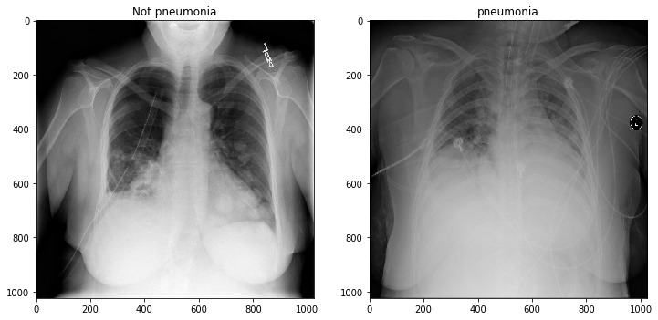
CHEST X-RAY

Slide 6
LITERATURE STUDY
S.NO | REFERENCE | ALGORITHM USED | DESCRIPTION | DATASET | ACCURACY/ OUTCOME
1 | [1] | CNN ,transfer learning for segmentation | Pneumonia area is erased and marked as non pneumonia sample. | Radiological Society of North America (RSNA) | Discriminative power of false positive samples is significantly improved.
2 | [2] | 121-layer dense Convolutional Neural Network (DenseNet) | Detects Pneumonia from Frontal-view chest X-ray images | Chest x-ray14 dataset released by wang et.Al | 15% accuracy using Frontal Images
3 | [3] | Multilayer OSELM | MLELM and OSELM put Forward Multilayer OSELM and apply to Chest Xray Dataset. | MNIST and Chest X-ray | MNIST-97% Chest X-ray-91.7%

Slide 7
S.NO | REFERENCE | ALGORITHM USED | DESCRIPTION | DATASET | ACCURACY/OUTCOME
4 | [4] | Residual Network, Mask Regional CNN. | Intensity from thorax x-ray images, a radiologist can diagnose whether pneumonia or not. | Kaggle RSNA Pneumonia Detection Challenge dataset. | Residual Network-85.6% Mask RCNN-78.06.
5 | [5] | CNN ,Residual Network Architecture. | Deep learning for classification task, which is trained with modified images through | cheXNet dataset. | 78.73%

Slide 8
S.NO | REFERENCE | ALGORITHM USED | DESCRIPTION | DATASET | ACCURACY/ OUTCOME
6 | [6] | ANN -AlexNet | Transfer Learning which is the process of Using the model which has been already trained, it is better than Random starting point | Stanford University dataset | Reduces the no of epochs of training necessary to converge to a functional model
7 | [7] | TDistributed Stochastic Neighbor Embedding based on K-means | Imbalance in dataset-AUC as error metric rather than accuracy | NIH | 60%

Slide 9
S.NO | REFERENCE | ALGORITHM USED | DESCRIPTION | DATASET | ACCURACY/OUTCOME
8 | [8] | DenseNet-169 | Customized model – CNN based feature Extraction and supervised classifier algorithm gives optimal solution | Chest x-ray dataset | Loss function is indeed being optimized but feature learned on training set are not generalizing to Validating set
9 | [9] | Analogic CNN | Based on linear space 3x3 template | Hospital dataset | Simulation image shows good performance Based on different grayscale

Slide 10
EXISTING SYSTEM
Expert Radiotherapist were Consulted to diagnose Pneumonia
Pneumonia detection based on K Nearest Neighbor (KNN) using chest X-Rays.
DRAWBACKS
Number of Radiotherapist count is minimal compared to that of Patients.
Accuracy is Subjective.

Slide 11
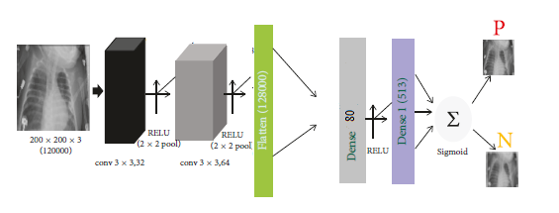
PROPOSED SYSTEM

Slide 12
Function | Explanations
Convolution2D | Convolutional layer, sliding window convolution to 2-dimensional input information;
MaxPooling2D | Maximum pooling layer, imposing a maximum pooling on the spatial domain signal;
RELU | Rectified Linear Unit, which performs linear rectification activation on the input vector of the upper layer neural network and outputs nonlinear results.
Flatten | The Flatten layer is used to translate the multidimensional input information into one-dimensional information.
Dense | It feeds all outputs from the previous layer to all its neurons, each neuron providing one output to the next layer.
Sigmoid | It is an activation function for multi-class neural network output.

Slide 13
PREPROCESSING AND AUGMENTATION
A smart library is made up of 5,856 x-ray images to preprocess the data. By using this smart library, it automatically recognizes the categories inside the dataset, resizes the images even if we do not specify the image size by default the image size is 50 x 50. Pickle object is used to reduce the time consumption for loading
the data.

Slide 14
REQUIREMENTS
HARDWARE REQUIREMENTS
• Memory -4.0 GB
• Processor Type -64 bit PROCESSOR
• Operating system -windows 8/windows 10

Slide 15








SOFTWARE REQUIREMENTS
Keras Jupyter NoteBook
TensorFlow Numpy Pandas
OpenCV Pickle Tkinter

Slide 16
IMPLEMENTATION
Steps to built the model are as follow,
1. The architecture of our proposed model consists of Two major layers i. Feature Extraction
ii. classifier.
2. Each layer in the feature extraction layer takes its immediate preceding layer's output as input.
3. Its output is passed as an input to the succeeding layers.
4. Our architecture consists of convolution , Relu, Max pooling and Classifier.
5. The feature extractors feature consists of Conv2D 3 X 3, 32; Relu activation function; Max pool 2D 2 X 2; conv2D 3 X 3, 64; Relu activation function; Max pool 2D 2 X 2; Flatten layer; Dense 80; Dense 1; sigmoid activation function ;
6. Classifier consist of Sigmoid Activation Function

Slide 17

ACCURACY
It is the ratio of the no. of true predicted instance both positive and negative to the total no. of instances.
True Positive: No. of instances predicted positive and are actually positive.
True Negative: No. of instances predicted positive but are actually negative.
Total no. of Instances: The sum of all the instances that have been classified by the classifier.

Slide 18
ACCURACY DETAILS
Dataset | Accuracy of Proposed Model
Training | 96.82%
Test | 98.53%
Validation | 98. 91%

Slide 19
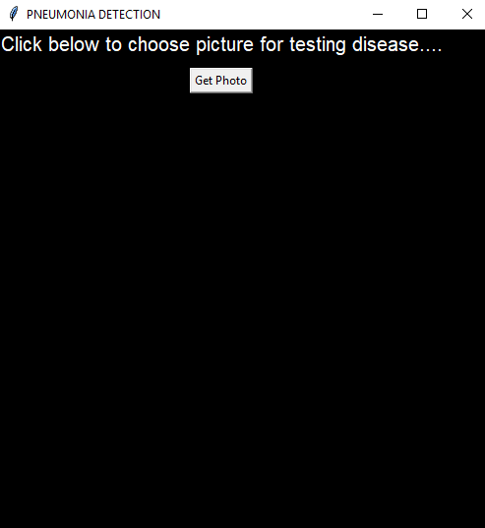
RESULTS
HOME PAGE:

Slide 20
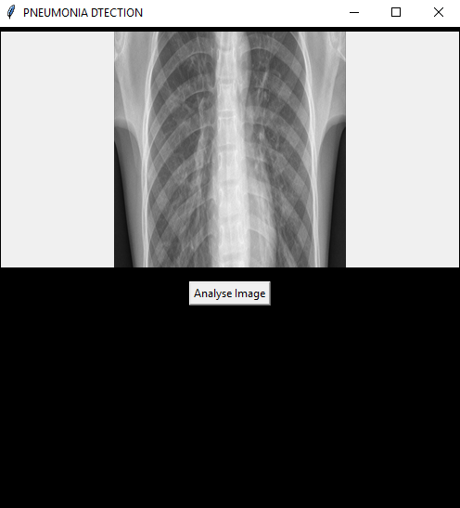
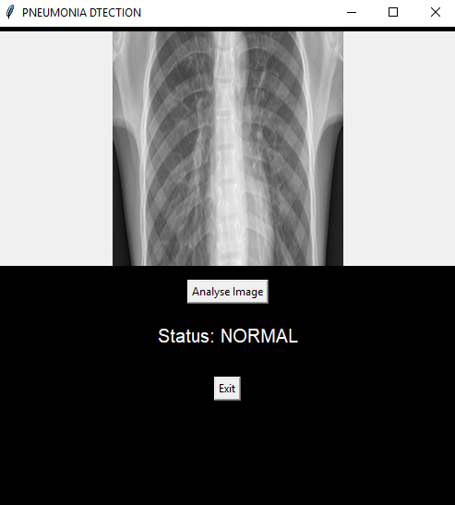
OUTPUT FOR NORMAL CXR

Slide 21
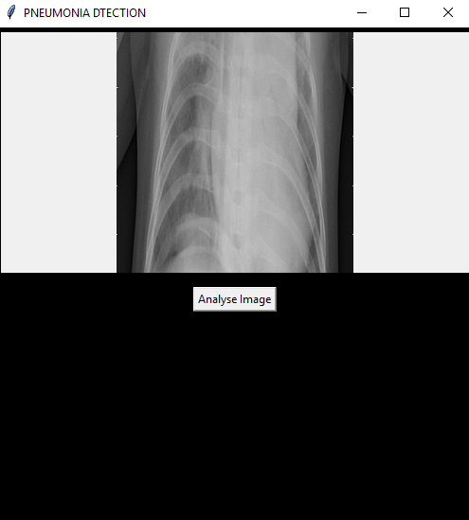
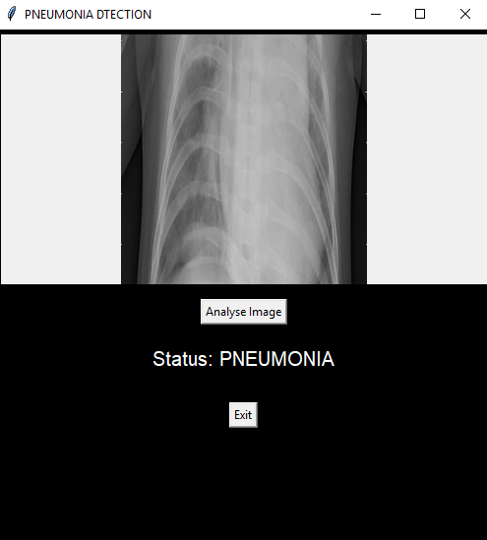
OUTPUT FOR PNEUMONIA CXR

Slide 22
REFERENCES
[1] Bingchuan Li and et al.,”Attention Guided Convolution Neural Network for Detecting Pneumonia on Chest X-Rays”(2019).
[2] Pranav Rajpurkar and et al.,” CheXNet: Radiologist-Level Pneumonia Detection on Chest X-Rays with Deep Learning”(2017)
[3] Sriram Vijendran and et al., ” Deep Online Sequential Extreme Learning Machines and Its Application in Pneumonia Detection ” (2019)
[4] Abdulla Faqih Al Mubarok and etal.,”Pneumonia Detection with Deep Convolution Architecture”.(2019)
[5]Deniz Yagmur Urey.,”Early Diagnosis of Pneumonia with Deep Learning”(2019)
[6] Lucas A. Wilson and et al.,” Fast and Accurate Training of an AI Radiologist”
[7] Benjamin Antin and et al.,”Detecting Pneumonia in Chest X-Rays with Supervised Learning”
[8] Dimpy Varshni and et al”Pneumonia Detection Using CNN based Feature Extraction”(2019).
[9] Azian Azamimi Abdullah,Norafifah Md Posdzi” Preliminary Study of Pneumonia Symptoms Detection Method using Cellular Neural Network”(2011).

Slide 23
PUBLISHED PAPER
We have published our Paper titled ”Pneumonia Detection using Chest X-Ray with Deep Learning” in International Research Journal of Enginnering and Technology(IRJET) Volume 7,Issue 4, April 2020 S.No: 530
Paper Downlod Link: https://irjet.net/archives/V7/i4/IRJET-V7I4530.pdf

Slide 24
THANK YOU

